Slide 1
Lecture 11: Linearization
Introduction
Linearization of a nonlinear function
Linearization of a nonlinear diff equation

Slide 2
Nonlinear Systems
Most real world systems are nonlinear in some respect
Friction, air drag, saturation, backlash
Nonlinear differential equations are difficult, if not impossible, to solve analytically
Transfer functions model only linear systems
Previously in the course we have numerically simulated nonlinear systems to determine behavior … difficult to design in this manner, can lack insight

Slide 3
Nonlinear Systems
Nonlinear functions can approximated by a linear function in a neighborhood about an operating point
First two terms of a
Taylor series expansion

Slide 4

Linearization of a Function
Let’s look at this in another way
Recall the definition of a Taylor Series expansion
For small $Δ$x the H.O.T. ≈ 0
Higher order terms (H.O.T.)

Slide 5
Example
_
Linearize f(v)=av² about v=v

Slide 6
Example
_
Linearize f(θ)=mgl sin θ about θ = θ

Slide 7
Nonlinear Systems
This same idea can be used for providing approximate models of nonlinear systems
Nonlinear diff eq → Linear diff eq in terms of deviation from the operating point (Δ)
These approximate models are only valid in a small neighborhood about the operating point

Slide 8
Linearizing Differential Equations
First thing that must be done is to identify the operating point about which to linearize
Since the operating point is an equilibrium solution of the dynamic equation, the derivatives must equal zero
Therefore, if x=f(x,u), the equilibrium solution is found from 0=f(x,u) where x and u are constants
.
_
_
_
_

Slide 9
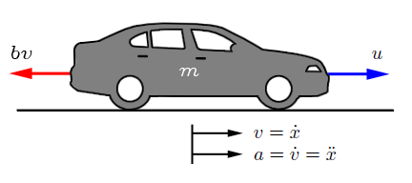
Example
_
_
.
Find the equilibrium solution (v, F) of F - av² = mv
f(v)
F

Slide 10
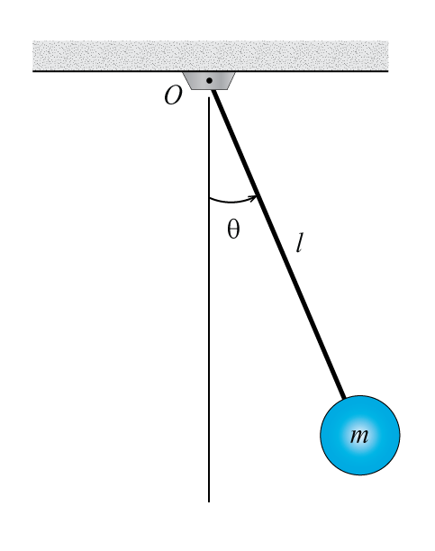
Example
_
..
_
Find the equilibrium solution (τ,θ) of τ - mgl sin θ =Jθ

Slide 11
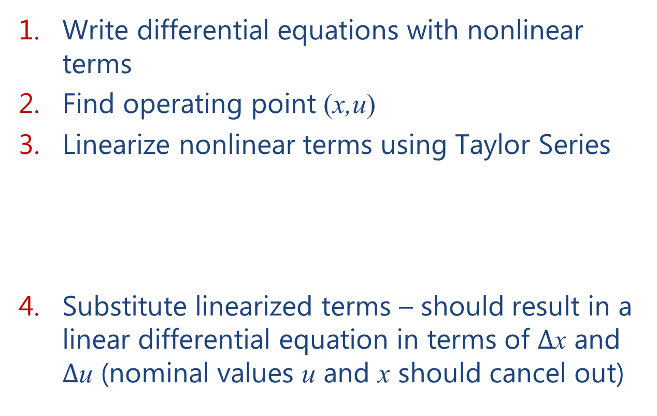
Overall Procedure
Write differential equations with nonlinear terms
Find operating point (x,u)
Linearize nonlinear terms using Taylor Series
Substitute linearized terms – should result in a linear differential equation in terms of $Δ$x and $Δ$u (nominal values u and x should cancel out)
_
_
_
_

Slide 12
Example
.
Linearize the differential equation F - av² = mv, for nominal input force F
_

Slide 13
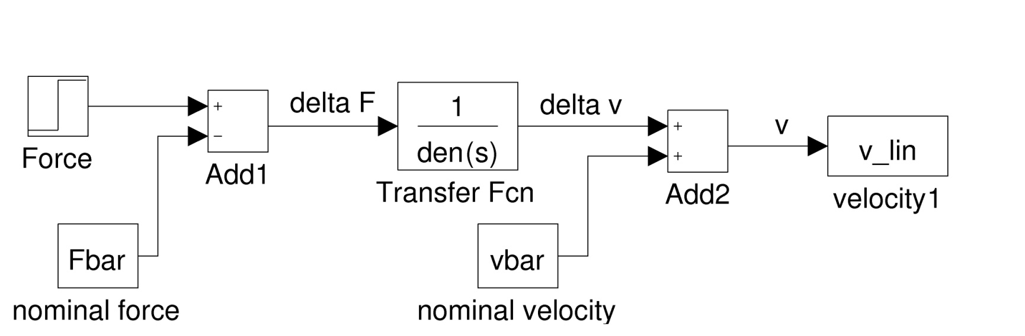
Example (continued)
Simulink model of linearized equation

Slide 14
Example
..
Linearize the differential equation τ - mgl sin θ =Jθ, for nominal input torque τ
_

Slide 15
Example
Linearize the differential equation , for a nominal input of u = 6

Slide 16
Example (continued)

